Slide 1

DATA 401 – Assignment 4 Data Set Analysis and Visualization
GROUP 5
Kristyll Avila, Andrew Da Costa and Binal Patel

Slide 2
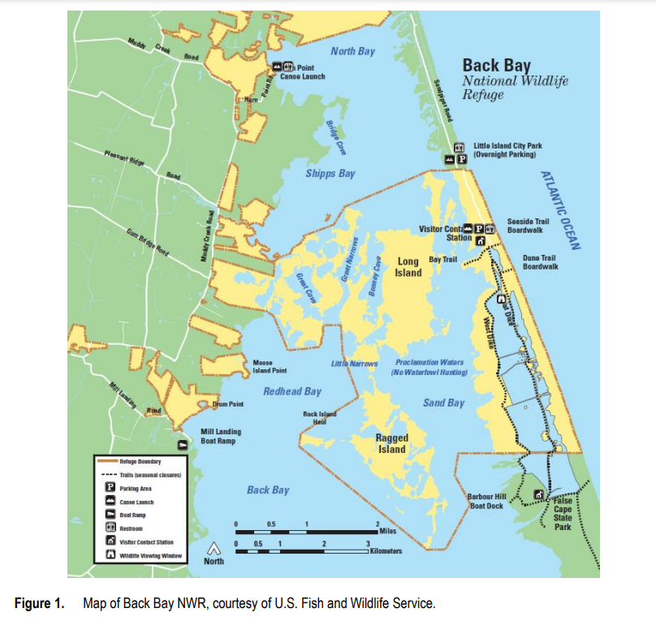
Questions for Dataset 1 (Water Quality)
Water samples taken every 2 weeks to ensure that water quality is adequate for aquatic life
Lengthy periods of undesirable water quality levels need controls put in place to meet state regulations

Slide 3
Questions for Dataset 1 (Water Quality)
How water temperature and salinity affects the dissolved oxygen solubility?
Does the water quality in the Bay meet Virginia State DEQ (department of environmental quality) regulations?
Do any adaptive controls need to be put into place to meet these regulations?

Slide 4
1. How water temperature and salinity affects the dissolved oxygen solubility? As salinity and water temperature increases the water solubility of dissolving oxygen is decreases.
Questions for Dataset 1 (Water Quality)

Slide 5
Questions for Dataset 1 (Water Quality)
2. Does the water quality in the Bay meet Virginia State DEQ (department of environmental quality) regulations, and do any adaptive controls need to be put into place to meet these regulations?
Moderate pH (7 – 8)
Moderate DO (5 - 8 mg/L)
Low Turbidity (High Secchi depth)
Low Salinity (0 – 2 ppt)

Slide 6
Questions for Dataset 1 (Water Quality)
3. Does the water quality in the Bay meet Virginia State DEQ (department of environmental quality) regulations, and do any adaptive controls need to be put into place to meet these regulations?
The Bay meets DEQ regulations because all water quality parameters are regularly within the specified ranges. Fluctuations occur based on factors such as the weather, however the water naturally regulates itself back within a suitable range. The water quality does not trend out of control for a prolonged period of time, so no adaptive controls need to be put in place.

Slide 7
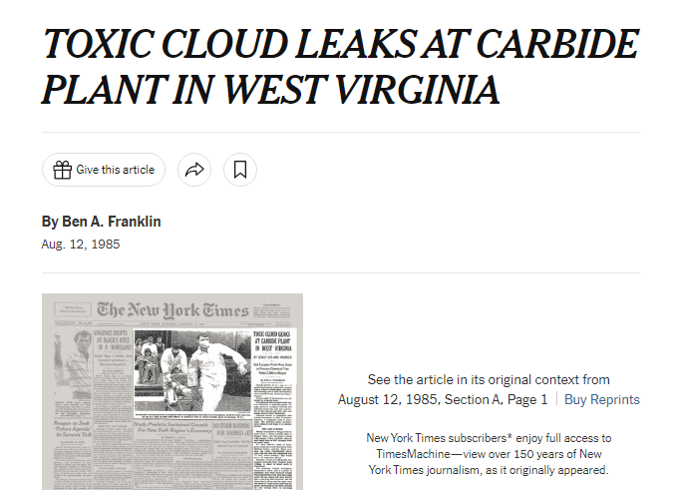
Questions for Dataset 2 (Toxics Release Inventory)
https://www.nytimes.com/1985/08/12/us/toxic-cloud-leaks-at-carbide-plant-in-west-virginia.html

Slide 8
Questions for Dataset 2 (Toxics Release Inventory)
What is the Toxics Release Inventory?
In 1986, TRI was a part of a new approach to environmental protection.
Toxics Release Inventory (TRI) tracks the management of certain toxic chemicals that may pose a threat to human health and the environment.

Slide 9
Questions for Dataset 2 (Toxics Release Inventory)
How did the distribution of chemical releases vary among different counties?
How did the distribution of chemical releases vary among different industry sectors? What does this imply about businesses in regards of their sustainability efforts?
Did the release of chemicals between 2009 to 2019 result in any negative impact on the environment?

Slide 10
Questions for Dataset 2 (Toxics Release Inventory)
How did the distribution of chemical releases vary among different counties? The top three counties mostly contributing on chemical releases are the City of Hopewell, City of Convington and Montgomery.
How did the distribution of chemical releases vary among different industry sectors? What does this imply about businesses in regards of their sustainability efforts?
The top contributing industry is other which refers to US Army and Navy operations, while the food industry being the least
It implies that businesses are implementing and taking sustainability efforts into effect.
Did the release of chemicals between 2009 to 2019 result in any negative impact on the environment?
The overall chemical quantity being released decreased overtime, therefore mitigating negative impact on the environment.

Slide 11
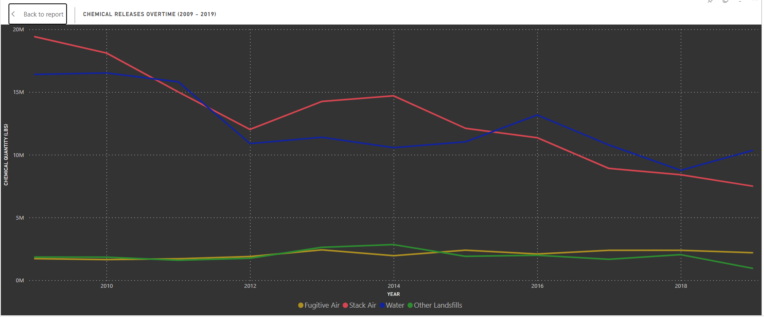
Conclusion
2001
2019
The toxic chemicals being released decreased in quantity overtime.
Indicates environmental health and safety practices are in place.
The chemicals being released are mostly in a form of surface water and stack air emissions.
The decrease in total chemical quantity being released is directly correlated to the improving water quality.
Water Quality in the Bay is up to DEQ standards as there is low salinity and turbidity, moderate pH, and moderate DO.

Slide 12
References
Water Quality. 2023. Does Salt or Salinity of Water Affect Solubility of Oxygen? APEC Water Systems. https://www.freedrinkingwater.com/water_quality/water-science/j-9-does-salt-concentration-salinity-water-affect-solubility-oxygen.htm#:~:text=Solubility%20of%20dissolved%20oxygen%20also,6%2D14%20mg%2FL
Back Bay National Wildlife Refuge. 2020. Water Quality Data. Virginia Beach, Virginia https://ecos.fws.gov/ServCat/Reference/Profile/117348
https://www.epa.gov/toxics-release-inventory-tri-program/what-toxics-release-inventory
United States Environmental Protection Agency. 2022. TRI Basic Data Files. https://www.epa.gov/toxics-release-inventory-tri-program/tri-basic-data-files-calendar-years-1987-present

Slide 13
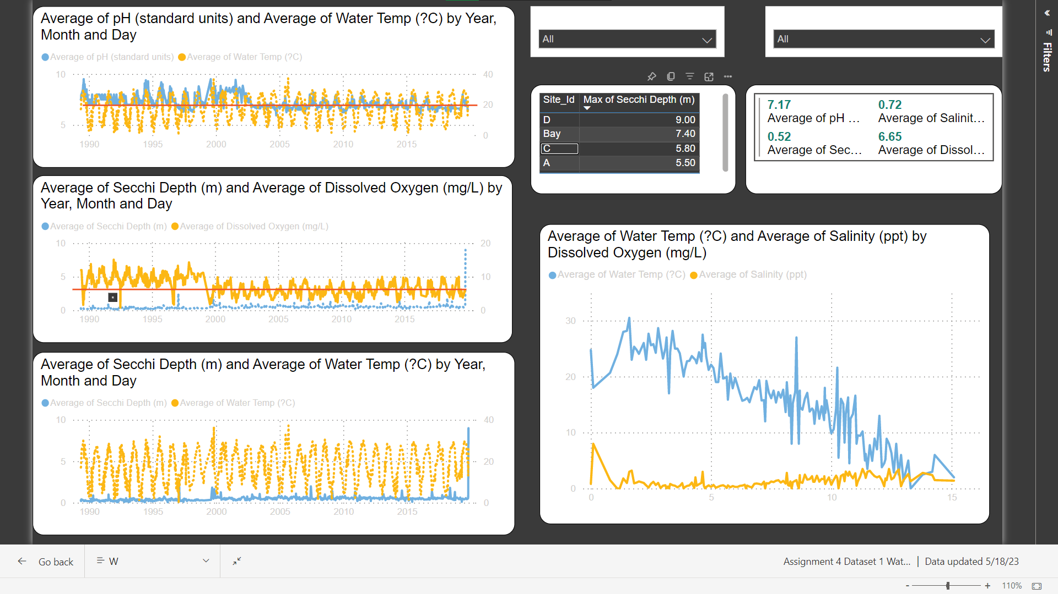

Slide 14
